Slide 1
Seminar
On
Digital Image Processing
Submitted To: Submitted By:
Mrs. Desny Antony Shilpa Joy
S5 MCA

Slide 2
Content
What is Image Processing ?
Applications
Purpose of Image Processing
Types of Image Processing
Components of Image Processing
Future Scope
Advantages
Disadvantages
Conclusion
Reference

Slide 3
What is Image Processing ?
Image Processing is any form of signal processing for which our input is an image, such as photographs or frames of video and our output can be either an image or a set of characteristics or parameters related to the image.
Image Processing generally refers to processing of two dimensional picture and by two dimensional picture we implies a digital image.
A digital image is an array of real or complex numbers represented by a finite number of bits.
But now in these days optical and analog image processing is also possible.

Slide 4
Applications
Face detection
Feature detection
Non-photorealistic rendering
Medical image processing
Microscope image processing
Morphological image processing
Remote sensing
Automated Sieving Procedures
Finger print recognition

Slide 5
Purpose of Image Processing
Visualization - Observe the objects that are not visible.
Image sharpening and restoration - To create a better image.
Image retrieval - Seek for the image of interest.
Measurement of pattern – Measures various objects in an image.
Image Recognition – Distinguish the objects in an image.

Slide 6
Types
Analog Image Processing
Digital Image Processing
Optical Image Processing

Slide 7
Components of Image Processing
Image Sensors
Image Displays
Image Processing
Software( OpenCV,Matlab,CIMG)
Image Processing Hardware
Memory

Slide 8
Digital Image
Digital image is composed of finite number of elements
Elements – Picture Elements, Image Elements, Pels or Pixels
Pixel is used to denote the elements of a digital image.
A digital image is a mapping from the real three-dimensional world to a set of two-dimensional discrete points. Each of these spatially distinct points, holds a number that denotes grey level or colour for it, and can be conveniently fed to a digital computer for processing.

Slide 9
Digital Image Processing(DIP)
Digital Image Processing deals with images which are two-dimensional entities (such as scanned office documents, x-ray films, satellite pictures, etc) captured electronically through a scanner or camera system that digitises the spatially continuous coordinates to a sequence of 0’s and 1’s.

Slide 10
Content
Digital image processing is the use of computer algorithms to create, process, communicate, and display digital images. Digital image processing algorithms can be used to:
Convert signals from an image sensor into digital images
Improve clarity, and remove noise and other artifacts
Extract the size, scale, or number of objects in a scene
Prepare images for display or printing
Compress images for communication across a network

Slide 11
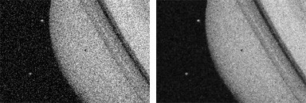
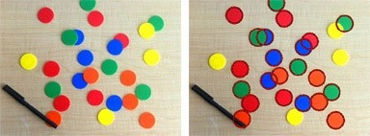
The following images illustrate a few of these examples:
Removing noise using a Wiener Filter.
Counting circular objects in an image.

Slide 12
Types Of Computerized Process
Low Level Process
Mid Level Process
High Level Process
Action : Primitive Operations
Input: Image Output: Image
Examples: Noise removal, image sharpening
Action :Segmentation
Input: Image Output: Attributes
Examples: Object recognition, classification & processing
Action : Making Sensation
Input: Attributes Output: Scene Understanding
Examples: recognition, analysis & associates with vision

Slide 13
Introduction to MAT LAB
MATLAB stands for matrix laboratory.
MATLAB is a high-performance language for technical computing.
It integrates computation, visualization, and programming in an easy-to-use environment.

Slide 14
Typical uses include
Algorithm development
Data acquisition
Modeling, simulation, and prototyping
Data analysis, exploration, and visualization
Scientific and engineering graphics
Math and computation
Application development, including graphical user interface building

Slide 15
Parts of MATLAB
Development environment :- set of tools and facilities that helps to use of MATLAB functions and files.
The MATLAB mathematical function library :-vast collection of computational algorithms ranging from elementary functions to more sophisticated functions
The MATLAB language :–consists of control flow statements, functions, data structures, input/output, etc.,
Graphics :-for two-dimensional and three-dimensional data visualization, image processing, animation, and presentation graphics
The MATLAB application program interface (API) :-library that allows you to write C and Fortran programs that interact with MATLAB.

Slide 16
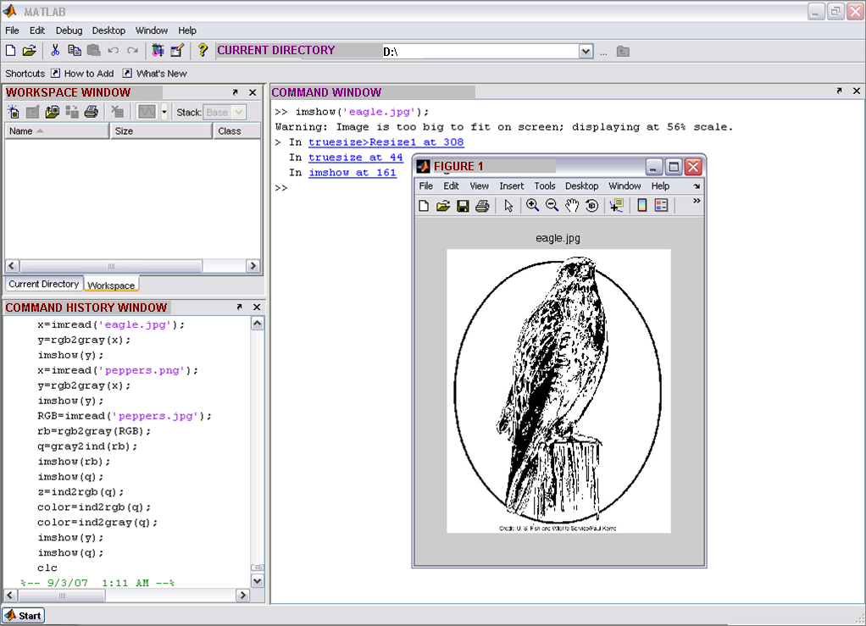
Working Environment of MATLAB

Slide 17
Future
We all are in midst of revolution ignited by fast development in computer technology and imaging.
Against common belief, computers are not able to match humans in calculation related to image processing and analysis.
But with increasing sophistication and power of the modern computing, computation will go beyond conventional, Von Neumann sequential architecture and would contemplate the optical execution too.

Slide 18
Advantages
This one is more accurate than the overlapping method because it is based upon minutia.
It is an interactive method for recognizing fingerprints.

Slide 19
Disadvantages
It is more time consuming as compared to the former.
More complex program.

Slide 20
Conclusion
Using image processing techniques, we can sharpen the images, contrast to make a graphic display more useful for display, reduce amount of memory requirement for storing image in for mation, etc., due to such techniques, image processing is applied in recognition of images´ as in factory floor quality assurance systems; image enhancement', as in satellite reconnaissance systems; image synthesis´ as in law enforcement suspect identification systems, and image construction´ as in plastic surgery design systems.

Slide 21
Reference
www.google.com
www.wikipedia.com
www.studymafia.org

Slide 22
Thanks

Slide 23
Queries?

